Slide 1
US Housing Price Prediction
Phuc Ton Nguyen

Slide 2
Problem identification
A local real estate company in US, asked to build a house price prediction model. The company wants to utilize the model to provide their house price estimations to their customers, house sellers and buyers. The goal of this project is collecting data with house prices and finding the best model that can predict house sale prices with the least amount of errors.

Slide 3
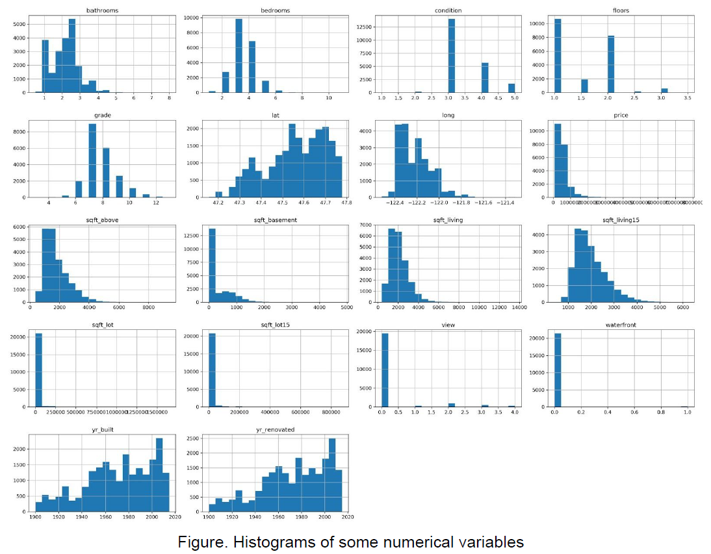
Recommendation and key findings

Slide 4
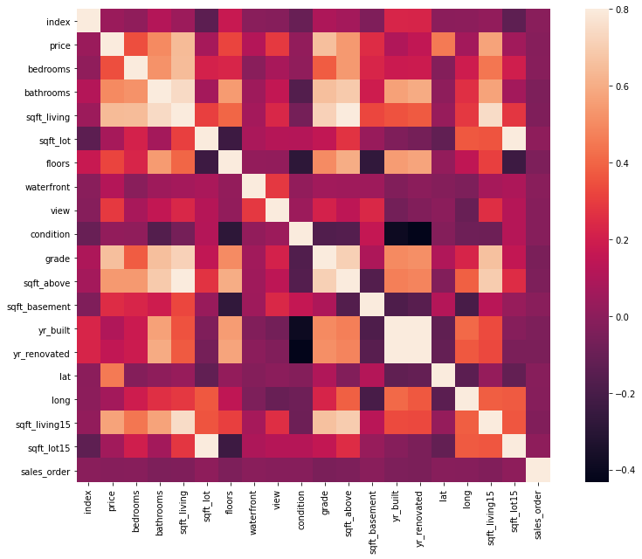
Recommendation and key findings

Slide 5
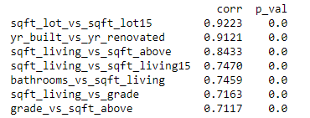
Recommendation and key findings
Correlation between independent variables

Slide 6
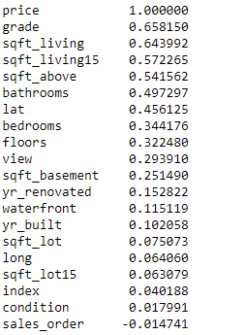
Recommendation and key findings
Correlations to price

Slide 7
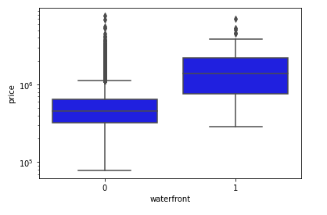
Recommendation and key findings
Relationship between house price and categorical independent variables

Slide 8
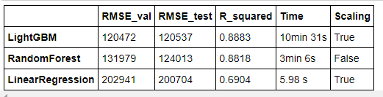
Modeling results and analysis

Slide 9
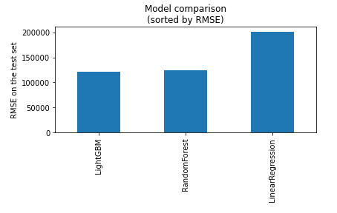
Modeling results and analysis

Slide 10
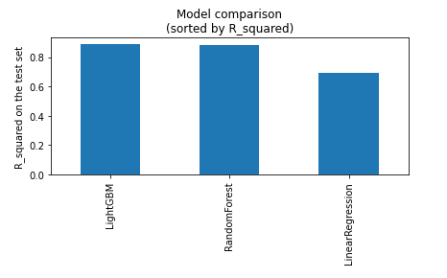
Modeling results and analysis

Slide 11
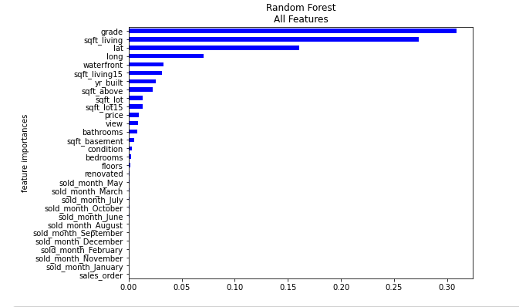
Modeling results and analysis
Important features:

Slide 12
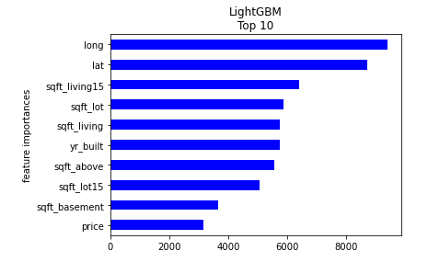
Modeling results and analysis
Important features:

Slide 13
Summary and conclusion
Both EDA and machine learning showed that square footages of living area, number of bathrooms and latitudes are important features in predicting house prices and they have positive correlation with house prices. Some important features, but not linearly related to house prices, are sold months and year built.
I have found the best house prediction models is the LightGBM models which showed high speed and best performance in RMSE. If one model should be selected I would recommend to use the LightGBM model since it is faster and it makes fewer outliers.

